Slide 1
Introduction
Installation/Running
The Basics
Datatypes

Slide 2
Basics ( To understand the code)
Indentation
Variables
Assignment is = and Comparison is ==
For numbers + - * % /
For strings + and % for string formatting or concatenation
Logical operators are words , and or not [ not symbols]
Basic printing command is print.
Naming rules.

Slide 3
Examples
Variables and Assignment
Multiple Assignment
Assignment and References

Slide 4
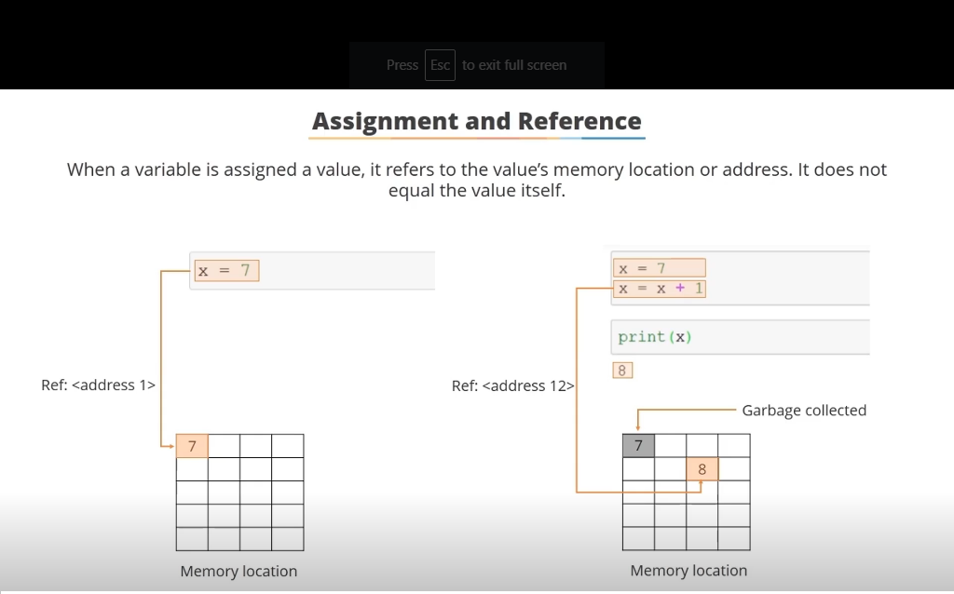

Slide 5
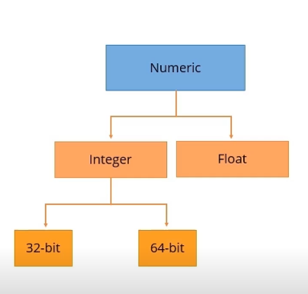
Data Types
Numeric
String
None
Boolean

Slide 6
TYPE CASTING
You can change data type of a number using Type casting.
Example

Slide 7
OPERATORS AND FUNCTIONS
Basic Operator
‘in’ operator
‘not in’ operator
‘+’ operator
‘*’ operator
Arithmetic operator
+, -, *, /, %

Slide 8
Assignment Operators
= | x = 5 | x = 5
+= | x += 3 | x = x + 3
-= | x -= 3 | x = x - 3
*= | x *= 3 | x = x * 3
/= | x /= 3 | x = x / 3
%= | x %= 3 | x = x % 3
//= | x //= 3 | x = x // 3
**= | x **= 3 | x = x ** 3
&= | x &= 3 | x = x & 3
|= | x |= 3 | x = x | 3
^= | x ^= 3 | x = x ^ 3

